Slide 1
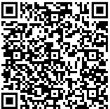
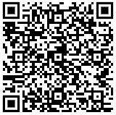
ODF and its Toolkit
Svante Schubert
ODP
PDF

Slide 2
Basics
What is a Standard?
A standard is a blueprint like a cooking recipe!
A standard creates interoperability (e.g. DINA4)
A standard improves reusability
A standard prevents Lock-In-Effect
A standard is lowering costs (e.g. share tests & validator)
Svante Schubert
Notes:
Interoperability: (from Latin opus 'work' and inter 'between').
A standard reduces costs:
Joint development
larger market
(not guaranteed but likely) higher quality because several teams/companies work together...
Reuse & further development of tests - tests/validation are part of the specification!
Also standards are in digital change (away from paper & PDF)!
In the future software will be generated from a standard (or the human readable standard & the reference software will be generated from the same data set).

Slide 3
Basics
What is a Standard?
A standard is a blueprint like a cooking recipe!
A standard creates interoperability (e.g. DINA4)
A standard improves reusability
A standard prevents Lock-In-Effect
A standard is lowering costs (e.g. share tests & validator)
A standard is usually published as PDF (digital stone)
Unfortunately no digitalisation for software standards, yet
Svante Schubert
Notes:
Interoperability: (from Latin opus 'work' and inter 'between').
A standard reduces costs:
Joint development
larger market
(not guaranteed but likely) higher quality because several teams/companies work together...
Reuse & further development of tests - tests/validation are part of the specification!
Also standards are in digital change (away from paper & PDF)!
In the future software will be generated from a standard (or the human readable standard & the reference software will be generated from the same data set).

Slide 4
Digitalisation
In a Nutshell - Automation
Everbody should be able at any time to:
Throw data over the digital fence &
automatically understand received data:
    Without human interaction!
    Without bi-lateral agreement!
Svante Schubert

Slide 5

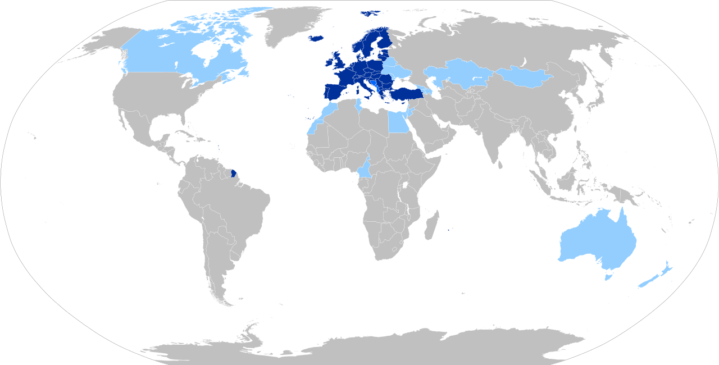
What is an EU Standard?
Who is CEN (Comité Européen de Normalisation)?
test
Member
Affiliates
Companion Standardization Bodies
Svante Schubert
Notes:
Each country has a national standardization organization, like DIN in Germany and AFNOR in France....
French Guiana - part of the European Union with the Euro as currency, but not part of the Schengen area!
https://www.cencenelec.eu/european-standardization/international-cooperation/global-outreach/companion-standardization-body/
One criterion for joining the EU is full integration into the European Standardization System (ESS) to ensure technical harmonization within the European Single Market.
https://en.wikipedia.org/wiki/European_Committee_for_Standardization#Membership
https://www.ferd-net.de/standards/was-sind-standards/index.html

Slide 6
What is an EU Standard?
Who is CEN (Comité Européen de Normalisation)?
test
EU members
3 members of European Free Trade Association (EFTA): Iceland, Norway, Switzerland
United Kingdom, North Macedonia, Turkey, Serbia
Member
Affiliates
Companion Standardization Bodies
Svante Schubert
Notes:
NEXT: Now what is CEN? Are there other standards? Don‘t be shocked!!

Slide 7
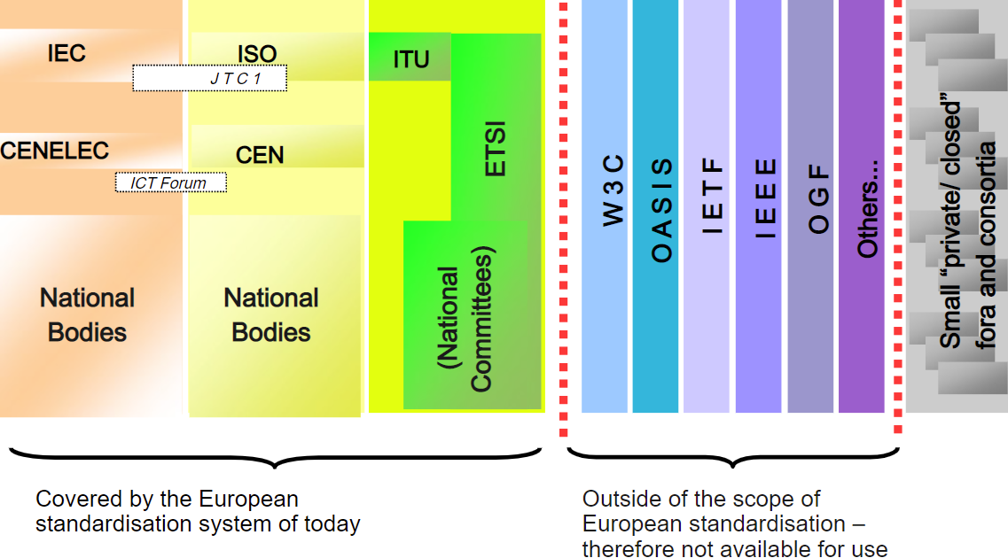
What is EU ICT Standardisation?
Information and Communication Technologies (ICT)
test
European Standardisationsystem
Outside of Scope
(not directly useable)
Obligatory by EU Regulation 1025/2012
Svante Schubert
Notes:
information and communications technology, ICT
Only the left side may be used as EU standard!
Which EU
electrotechnical standards from CENELEC systems using electricity
telecommunication standards from ETSI about transmission of information
all the rest from CEN
A regulation is a legal act of the European Union^{[1]} that becomes immediately enforceable as law in all member states simultaneously. EU-Verordnung
A directive is a legal act of the European Union^{[1]} that requires member states to achieve a particular result without dictating the means of achieving that result. EU-Richtlinien
80% of economic laws nowadays coming from Bruxelles

Slide 8
What is EU ICT Standardisation?
Information and Communication Technologies (ICT)
test
European Standardisationsystem
Outside of Scope
(not directly useable)
Obligatory by EU Regulation 1025/2012
Svante Schubert
Notes:
Slide created by ANTONIO CONTE (click leads to his presentation) - works for EU - phoned him, too, on his view and possible reforms...

Slide 9
What is EU ICT Standardisation?
Information and Communication Technologies (ICT)
Electrical engin.
Other
Telecommunic.
World
test
EU
Nation
European Standardisationsystem
Outside of Scope
(not directly useable)
Obligatory by EU Regulation 1025/2012
Svante Schubert
Notes:
Folie from ANTONIO CONTE (click leads to his presenation) – works for EU – phoned him, too, on his view and possible reforms…
OASIS ODF Standards is being submitted via „Fast Path“ to ISO..
No semantic/syntax is being changed at ISO only editorial
Closed ISO standard should be avoided

Slide 10
OASIS and ISO ODF Standard
Difference
ISO standard is the “queen” of standards
Governments are obligated to use ISO standards
Government of Great Britain demands the use of ODF
ISO standard is usually not free and not open
OASIS ODF standard is given to ISO via „fast path“
ODF ISO standard only differs on editoral level
ODF Standard is only maintained on OASIS level
https://www.oasis-open.org/committees/tc_home.php?wg_abbrev=office
Svante Schubert

Slide 11
OASIS and ISO ODF Standard
Status
ODF 1.3 was published (27. April 2021)
ISO standard ODF 1.3 is “in the queue”
OASIS TC has a feature freeze for ODF 1.4
https://www.oasis-open.org/committees/tc_home.php?wg_abbrev=office
Svante Schubert

Slide 12
OASIS OpenDocument Technical Committee (TC)
Voting Members
Patrick Durusau [OASIS TC chair & editor]
Svante Schubert [OASIS TC chair & editor]
Francis Cave [OASIS TC secretary & editor]
Michael Stahl [OASIS TC editor] (allotropia)
Regina Henschel (TDF)
Alfred Hellstern (Microsoft)
Prof. Andreas Guelzow (worked on Calligra - left mid 2023)
https://www.oasis-open.org/committees/tc_home.php?wg_abbrev=office
Svante Schubert

Slide 13
ODF Features
OASIS ODF 1.4 issues
Feature freeze for ODF 1.4 at the OASIS TC
OASIS issues tracker (for ODF Syntax and/or Semantic)
  77 issues for ODF 1.4 in OASIS issue tracker
GitHub issue tracker (for editorial issues of specification)
  5 editorial issues on ODF 1.4 specification
  GitHub for Software Tooling required for ODF spec delivery
Svante Schubert
Notes:
GitHub for ODF to HTML transformation (Michael Syncs, I fix)
Michael added Java for zip/unzip the ODF
----
GitHub - all the tooling
* HTML transformation
* PDF export
* All editors using the same LibreOffice Version
with Indent (for GitHub extraction)
* Java tooling (by Michael)
zip/unzip the XML (taking care of mimetype in the beginning uncompressed)

Slide 14
ODF Features
ODF Status of LibreOffice
TDF Budget 2023:
  Missing ODF Features (general collection)
  Missing ODF Features: Attribute svg:d of <draw:path>
  some of the possible commands are missing
  Missing ODF Features: Draw:shadow-offset-x/y only
  partially implemented
  Missing ODF Features: The attribute draw:text-rotate-angle
  is interpreted, but there exists no user interface to change it.
  Missing ODF Feature: <draw:regular-polygon> missing completely
  Improve release process of ODF versions (Automation)
TDF Budget 2024: Transition to ODF 1.4
Svante Schubert

Slide 15

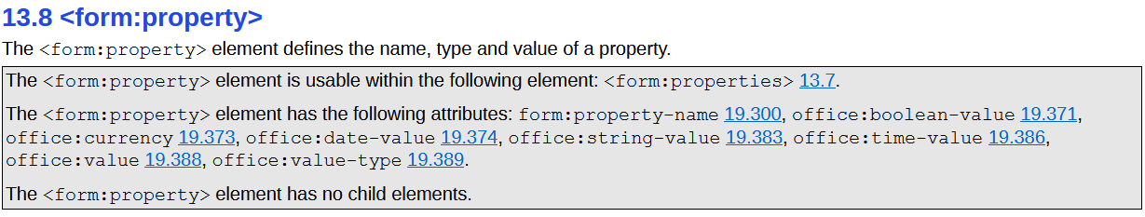
ODF Specification
Generation missing
https://docs.oasis-open.org/office/OpenDocument/v1.3/os/part3-schema/OpenDocument-v1.3-os-part3-schema.html#element-form_property

Slide 16

Basics
What is a ODF?
ODF document is a ZIP (of mostly XML)
                ODF Package
                (OASIS spec. part 2)
                ODF XML
                (OASIS spec. Part 3)
https://docs.oasis-open.org/office/OpenDocument/v1.3/os/
Notes:
ODF Package is defined by:
OASIS specification part 3 (ODF 1.3) – Part 2/1.3
XML Manifest (content table),
encryption,
signature
EPUB Format used ODF 1.1 unfortunately became incompatible to ODF 1.2 (miscommunication?)
ODF XML is defined by:
OASIS specification part 1 (ODF 1.2) – Part 3/1.3
XML (content,styles,meta) files
ODF 1.3 - released 27. April 2021

Slide 17
Basics
What is a ODF?
ODF document is a ZIP (of mostly XML)
                ODF Package
                (OASIS spec. part 2)
                ODF XML
                (OASIS spec. Part 3)
OASIS ODF Primer missing:
Semantic and Syntax in a Nutshell
https://docs.oasis-open.org/office/OpenDocument/v1.3/os/
Notes:
W3C has Primer – might be a good idea for all ODF applications as initial technical lecture

Slide 18
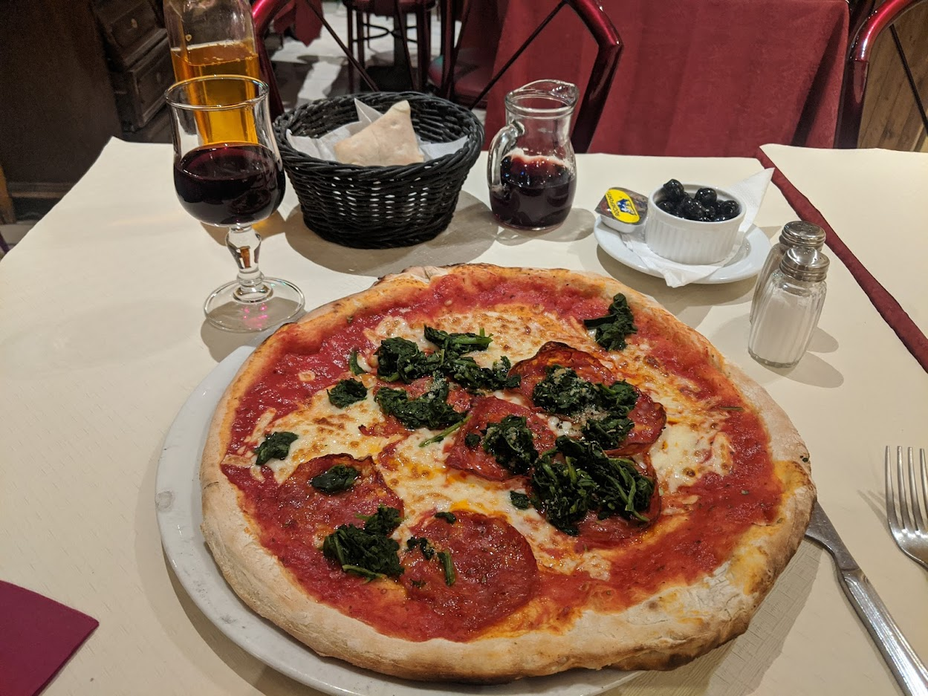
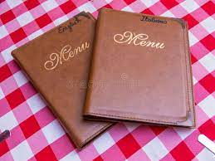


Basics
What is Semantik & Syntax?
Semantic (Wine) described by Syntax/Language (wine/vino)
Svante Schubert
Notes:
Syntax ~= Satzlehre
(altgriechisch σύνταξις syntaxis, von σύν syn ‚zusammen‘ und τάξις taxis ‚Ordnung, Reihenfolge‘)
Together - Order, sequence
Different syntaxes are also encountered in everyday life...
As when you go out to eat with international friends and menus in different languages, which is subject to a different syntax!)
The food (the meaning/semantics of the syntax) always remains the same for everyone!
In short:
The same food is described in different languages (syntax)!
TECHNICIANS SHOULD REMEMBER:
Human semantics is the smallest natural common multiple of different syntaxes!

Slide 19
Office Document Semantics
Features and Subfeatures
Required to split complexity: How to eat an elefant?
Semantics is what the common user “knows“
Semantics are known accross file formats (e.g. table)
Semantics of file format are the features
Subfeature
If a feature (e.g. table background color) does not exist
without its parent (table) it is a subfeature
There can be many syntaxes (XML, JSON..) for a semantic
Svante Schubert

Slide 20
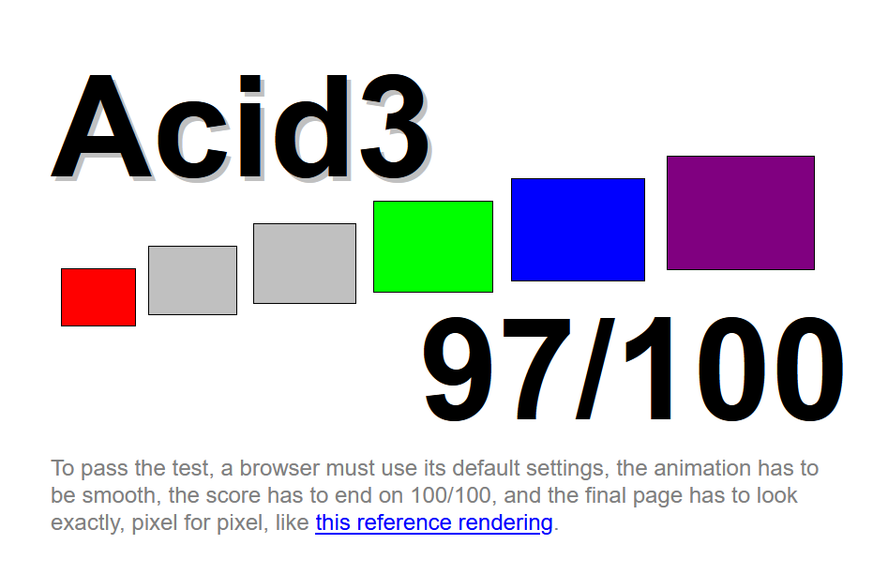
Document Standards
API on Semantic & Syntax
ODF XML only the final state of a document (load / save)
ODF defines no state changes (e.g. column insertion in table)
No state changes == no API == no regression test at standard
Like HTML/CSS ACID regression tests
Are such interoperable API / Tests / Macros desired?
Remember Change Tracking becomes easier after defining Changes!
http://acid3.acidtests.org/
Svante Schubert
Notes:
Interoperabilität:
(von lateinisch opus ‚Arbeit‘ und inter ‚zwischen‘)
(from Latin opus 'work' and inter 'between')

Slide 21
Document Standards
API on Semantic & Syntax
ODF XML only the final state of a document (load / save)
ODF defines no state changes (e.g. column insertion in table)
No state changes == no API == no regression test at standard
Like HTML/CSS ACID regression tests
Remember Change Tracking becomes easier after defining Changes!
Are such interoperable Tests / Macros / API desired?
http://acid3.acidtests.org/
Svante Schubert

Slide 22
Document Standards
Semantic Features and their Changes
How to find a Semantic API?
Find semantic features (feature tree of ODF)
What can be added / changed / deleted via LO GUI?
User feature (and their state changes)
Analysis of ODF grammar – What elements stick together?
What is the vocabulary on features used by
ODF specification?
What is the vocabulary on features used by LO
documentation and / or testing?
Svante Schubert

Slide 23
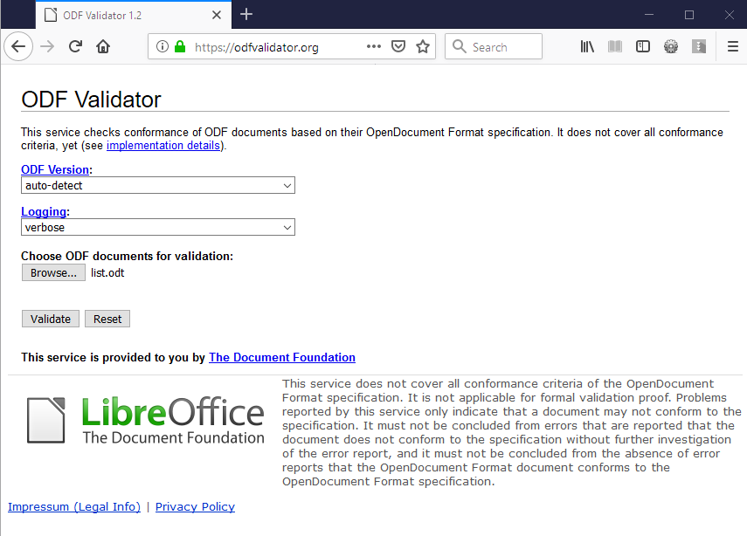
Notes:
The only tool with a GUI is the ODF Online Validator..
Hosted by at odfvalidator.org
Coming with GUI and validator bundled as a JEE WAR (Web Archive) easily to be added to a a Web Application Server, such as Apache Tomcat
2011 small funding from Nlnet: provide GUI & WAR

Slide 24
ODF Toolkit
Use Cases (1/2)
Online Validator (or via commandline)
https://odfvalidator.org/
Running XSLT directly on ODF document (no unzipping XML)
Notes:
- The ODF validator is hosted by TDF the Document Foundation!
- Who knows XSLT? Running on the zipped XML within the ODF without the need to unzip the files.

Slide 25
ODF Toolkit
Use Cases (2/2)
Editing an ODF document (e.g. Cloud)
  by API without Layout
  for Data Insertion (e.g. by Database)
  for Data Extraction (e.g. Translation)
Collaboration on Text Documents (ODT)
  backend for Web Offices
  (e.g. OX Documents)
  (since ODFDOM v0.10.0 – Nov ´21)
https://odftoolkit.org/docs/presentations/character-styles.odt
https://odftoolkit.org/docs/presentations/character-styles.json
java -jar odfdom.jar character-styles.odt
Notes:
- Main Module ODFDOM:
ODF manipulation by API on server
A) New Data in templates
Create ODF from Database:
1. Get visible text – 2. translate – 3. exchange existing text!
- COLLABORATION with ODFDOM (soon with 1.0.0)

Slide 26
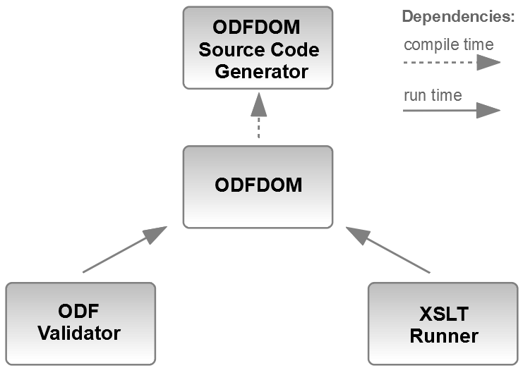
ODF Toolkit
Architecture
Notes:
XSLT Runner relies on ODFDOM
The ODF document is loaded by ODFDOM and the XML streams are provided to the XSLT processor, references within the XML resolved into the ZIP.

Slide 27
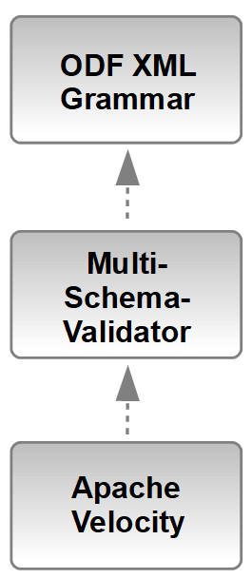
ODFDOM
Source Code
Generator
Architecture
OASIS XML grammar: ~18000 text lines
~600 XML elements
~1200 XML attributes
XML Valdiator -
reads many
XML grammars
template engine generating sources
by text templates having a context with Java access
Notes:
In the very first approach XSLT was used to create from the ODF XML grammar the Java sources.
We split the complexity and
reused existing opensource software:
a) Multi-Schema-Validator (MVS)
to read the XML grammar
b) Apache Velocity Engine as Template engine
With ODF Toolkit 0.10.0 introduced common tree data structure to allow other tooling on the XML grammar

Slide 28

ODF GrammaR - text hard to Answer
Can a
paragraph <text:p>
be nested
in a valid document?
🤔🙄
ODF 1.2 XML:
598 XML Elements
1301 XML Attributes
>18k lines
Notes:
- Grammar hard to understand
- Only basic set of information to define changes
- hard to standarizse changes
- Analysis difficult..

Slide 29
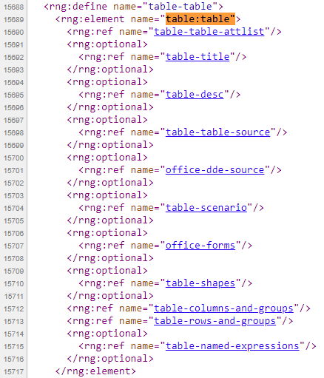
ODF Grammar - text hard to read
ODF 1.3 XML:
606 XML Elements
1317 XML Attributes
>18k lines
https://docs.oasis-open.org/office/OpenDocument/v1.3/os/schemas/OpenDocument-v1.3-schema-rng.html
Notes:
- Grammar hard to understand
- Only basic set of information to define changes
- hard to standarizse changes
- Analysis difficult..

Slide 30
ODF Grammar - text
Analyze Grammar generate Sources
Generation of
ODFDOM sources
Java class for each XML Elements
Java class for each XML Attributes
ODF 1.3 XML:
606 XML Elements
1317 XML Attributes
>18k lines
https://docs.oasis-open.org/office/OpenDocument/v1.3/os/schemas/OpenDocument-v1.3-schema-rng.html
Notes:
- Grammar hard to understand
- Only basic set of information to define changes
- hard to standarizse changes
- Analysis difficult..

Slide 31


Sources generated for ODF xml one Name different CONTENT
Different Parent
Beyond parent <manifest:manifest>
Two possibilites for @manifest:version
“1.3”
String
Beyond parent <manifest:file-entry>
https://docs.oasis-open.org/office/OpenDocument/v1.3/os/schemas/OpenDocument-v1.3-manifest-schema-rng.html
Notes:
The generated parent needs to deal with the difference!

Slide 32
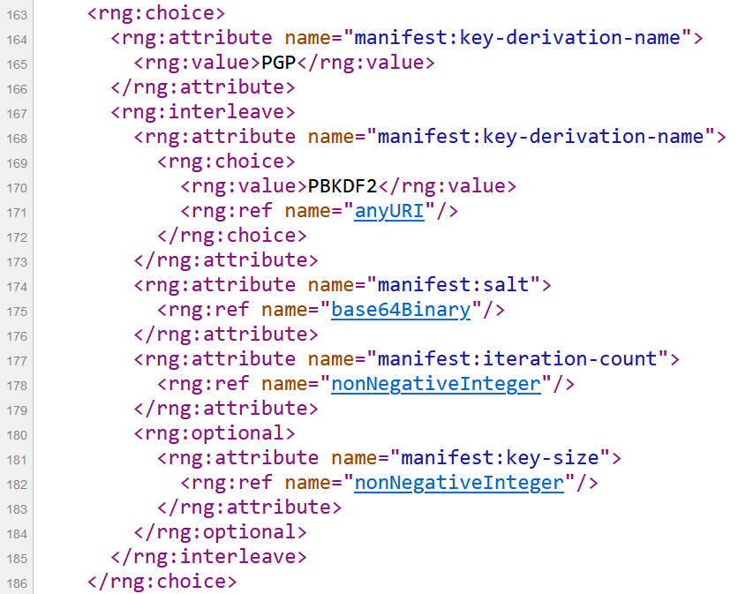
Sources generated for ODF xml one Name different CONTENT
ONE Parent
Same parent <manifest:key-derivation>
@manifest:key-derivation-name
Value „PGP“ →
no other attributes
Value „PBKDF2“ or anyURI →
3 other attributes
https://docs.oasis-open.org/office/OpenDocument/v1.3/os/schemas/OpenDocument-v1.3-manifest-schema-rng.html#key-derivation-attlist
Notes:
The parent likely provide different constructors!

Slide 33
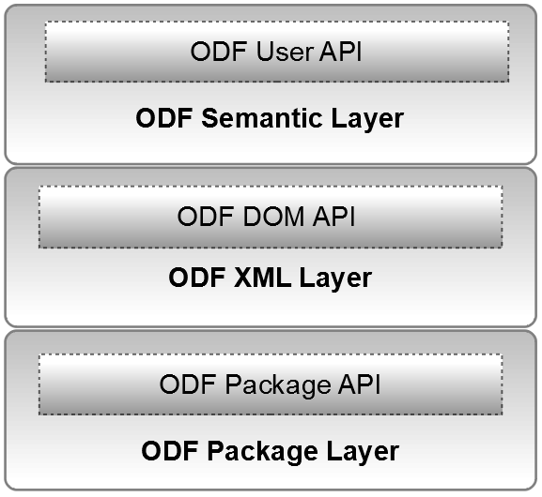
ODFDOM
Architecture
3.
2.
1.
Notes:
1. The lowest first API is the Package API.
Taking care of unzipping, add/read/delete ZIP‘s content and updating content table.
[NOTE: PKG API NOT OWN JAR DUE TO
HARD CODED DOC LOADER DETECTION]
Providing:
a) Document support (being a directory with MIME TYPE in ODF)
b) XML support (access and caching the DOM)
2. DOM API is generated from the ODF XML Schema, should contain all implementation details and providing the corsett of XML validness#
3. User API currently hand written (in future mostly generated) should provide all functionality from easy user semantic perspective by accessing the underlying layers.

Slide 34
ODFDOM
Architecture (in spe)
3.
public
2.
private
1.
Notes:
Unfortunately ODF applications do not have an interoperable RunTime Environment, like browsers having the DOM Model, which is the reason that JavaScript works across different browsers and ACID tests work (loading document shows level of support).
LibreOffice knows nothing about XML after loading.
There is a much better interoperability over semantic.
Every ODF applications allows add/modify/delete the same semantic entities (like paragraph, character, table, image, etc.) and their properties (bold, color, border width, etc.), we are working out the semantic model and its initial API, the User API.
Only User API should be public (or the other APIs public, but only an exchangeable implementation detail).

Slide 35
ODF Toolkit
Resources
Website:
https://odftoolkit.org/
https://tdf.github.io/odftoolkit/docs/ (latest)
Sources:
https://github.com/tdf/odftoolkit
Online Validator (hosted by TDF)
https://odfvalidator.org/
ODF Specification
http://docs.oasis-open.org/office/OpenDocument/v1.3/os/
ODF Specification Tooling
https://github.com/oasis-tcs/odf-tc/

